Slide 1

Introduction to Digital Signal Processing
CSE430:
DIGITAL SIGNAL PROCESSING
Acknowledgement for lecture slides – Dr. Mohammad Zavid Parvez

Slide 2

What is a Signal? What is a System?
Signal:
  Any physical quantity that varies with time, space, or any other independent variable or variables
  Examples: pressure as a function of altitude, sound as a function of time, color as a function of space
System:
  A physical device that performs an operation on a signal
  Exemples: analog amplier, noise canceller, communication channel, transistor

Slide 3
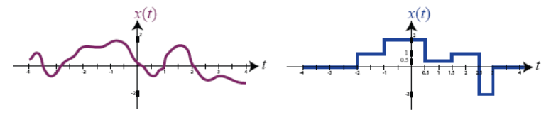
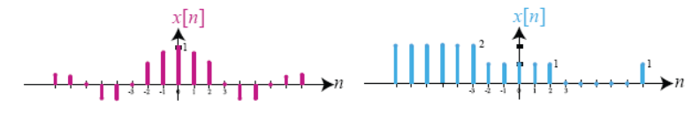
Continuous-Time versus Discrete-Time Signals
Continuous-Time Signals:
  Signal is defined for every value of time in a given interval (a; b) where a ≥ ─ ∞ and b ≤ ∞.
  Examples: voltage as a function of time, height as a function of pressure, number of positron emissions as a function of time.
Discrete-Time Signals:
  Signal is defined only for certain specific values of time; typically taken to be equally spaced points in an interval.
  Examples: number of stocks traded per day, average income per province.

Slide 4
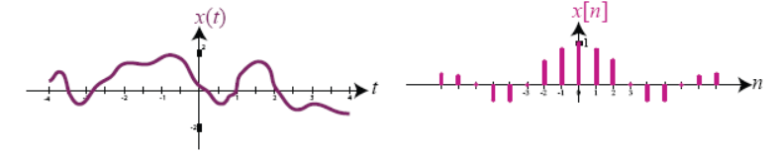
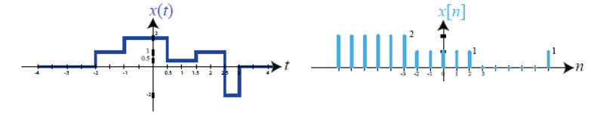
Continuous-Amplitude versus Discrete-Amplitude
Continuous-Amplitude Signals:
  Signal amplitude takes on a spectrum of values within one or more intervals
  Examples: color, temperature, pain-level
Discrete-Amplitude Signals:
  Signal amplitude takes on values from a finite set
  Examples: digital image, population of a country

Slide 5
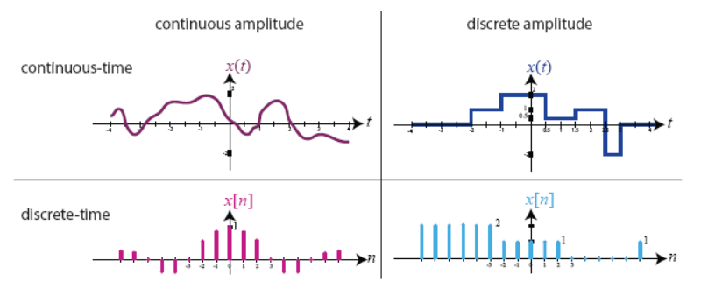
Analog and Digital Signals
analog signal = continuous-time + continuous amplitude
digital signal = discrete-time + discrete amplitude
  Analog signals are fundamentally significant because we must interface with the real world which is analog by nature.
  Digital signals are important because they facilitate the use of digital signal processing (DSP) systems, which have practical and performance advantages for several applications.

Slide 6
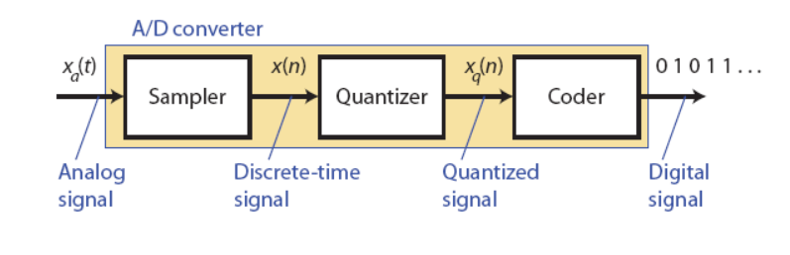
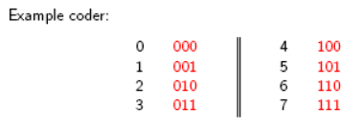
Analog-to-Digital Conversion
Sampling:
  conversion from cts-time to dst-time by taking samples at discrete time instants
  E.g., uniform sampling: x(n) = xa(nT) where T is the sampling period
Quantization:
  conversion from dst-time cts-valued signal to a dst-time dst-valued signal
  quantization error: eq(n) = xq(n) - x(n) for all n Є Z
Coding:
  representation of each dst-value xq(n) by a b-bit binary sequence
  e.g., if for any n, xq(n) Є {1; : : : ; 6; 7}, then the coder may use the given mapping to code the quantized amplitude:

Slide 7

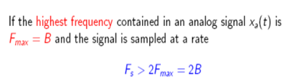

Sampling Theorem
Sampling is a core aspect of analog-digital conversion. One huge consideration behind sampling is the sampling rate - How often do we sample a signal so we can accurately recreate it?
Effect of under sampling (Aliasing) -problem???
Sampling frequency (rate) is at lease twice of the highest (max) frequency of the component.

Slide 8
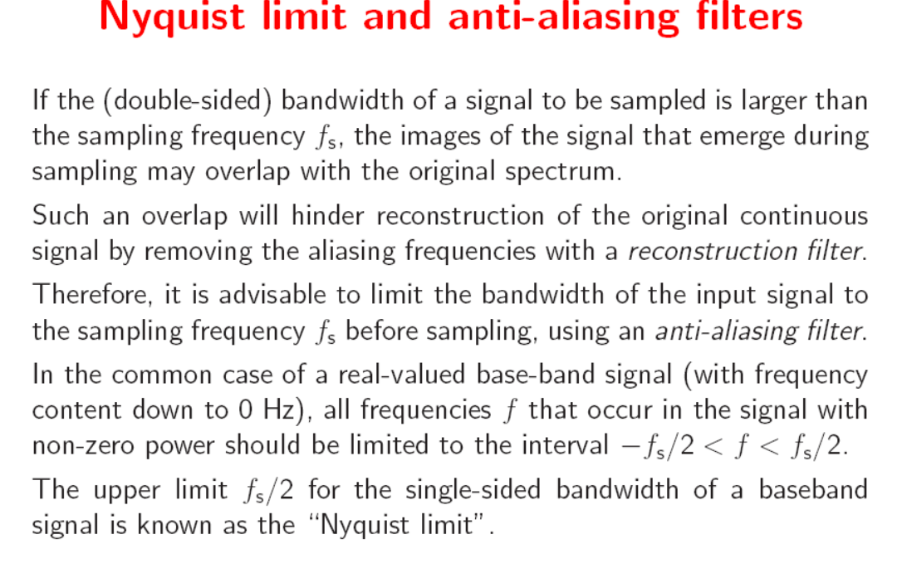
Sampling Theorem
Aliasing is a condition in which different signals when sampled become indistinguishable. It also refers to the distortion that result when the signal reconstructed from samples is different than the original continuous signal.

Slide 9
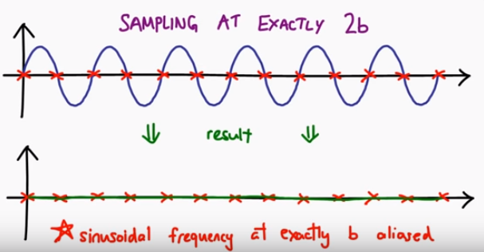
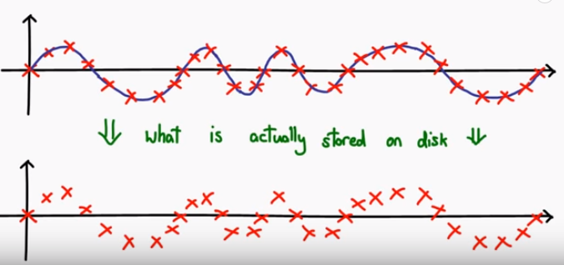
Sampling Theorem

Slide 10
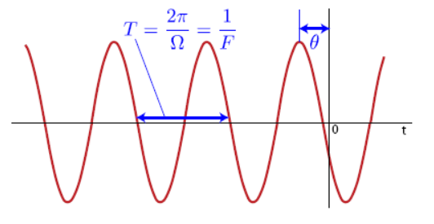
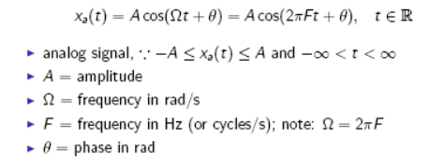
What is a “pure frequency” signal?

Slide 11

Continuous-time Sinusoids
for F Є R, xa(t) is periodic
i.e., there exists Tp Є R+ such that xa(t) = xa(t + Tp)
distinct frequencies result in distinct sinusoids
i.e., for F1 ≠ F2, Acos(2πF1t + θ) ≠ Acos(2πF2t + θ )
increasing frequency results in an increase in the rate of oscillation of the sinusoid
i.e., for , Acos(2πF1t + θ) has a lower rate of oscillation than Acos(2πF2t + θ )

Slide 12
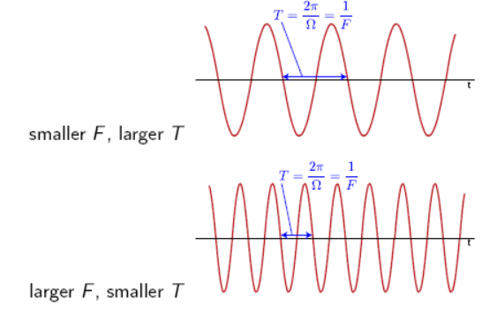
Continuous-time Sinusoids: Frequency

Slide 13
Discrete-time Sinusoids
discrete-time signal (not digital), -A≤xa(t)≤A and n Є Z
A = amplitude
ω = frequency in rad/sample
f = frequency in cycles/sample; note: ω = 2πf
θ = phase in rad

